Slide 1
Algorithmic Thinking
COSC1309
with slides from Brookshear chapter 5
Notes:
Always new languages to learn, but good fund. Prog. Skills will never be outdated.
Sw development requires well-developed logical and reasoning skills
Designing a solution is an iterative process, not a linear one.
Research shows that novice programmers struggle with designing solutions, not with syntax of a language.
Knowing a technique for writing design flow is helpful when hammering out a design.

Slide 2
Definition of Algorithm
An algorithm is an ordered set of unambiguous, executable steps that defines a terminating process.
The intelligence of the author is encoded into the steps of the algorithm. Thus, the performance of the steps no longer requires an understanding of the principles on which the algorithm is based. Instead the process is reduced to merely following directions. This is a fundamental concept of computer science!!

Slide 3
Algorithm Representation
Algorithm representation requires well-defined primitives.
A collection of primitives becomes an algorithm.
Often when a programmer is solving a problem, he writes an algorithm first in what can be called “pseudocode”. Once he determines the algorithm is correct, then he translates it into a particular high level programming language.
A High Level Programming Language can be thought of as a collection of programming “primitives” or structures used to write computer programs.

Slide 4
Page 211

Slide 5
Page 210 example of an origami algorithm using the primitives from previous slide.

Slide 6
G. Polya’s Problem Solving Steps (Polya was a mathematician who presented the following in 1945 as the Phases of Problem Solving.)
1. Understand the problem.
2. Devise a plan for solving the problem.
3. Carry out the plan.
4. Evaluate the solution for accuracy and its potential as a tool for solving other problems.

Slide 7
Getting a Foot in the Door
Try working the problem backwards
Solve an easier related problem
Relax some of the problem constraints
Solve pieces of the problem first (bottom up methodology)
Stepwise refinement: Divide the problem into smaller problems (top-down methodology)

Slide 8
Chain Separating Problem: Can you think outside the box?
A traveler has a gold chain of seven links.
He must stay at an isolated hotel for seven nights.
The rent each night consists of one link from the chain.
What is the fewest number of links that must be cut so that the traveler can pay the hotel one link of the chain each morning without paying for lodging in advance?

Slide 9
Basic Control Structures used in High Level Programming Languages:
Sequence
Selection
Iteration
Subprogram
Notes:
All programming languages provide 4 basic control structures
Every kind of executable statement can be categorized under one of these.
A design consists of any combination of these. Use indentation and key words to show flow of control.

Slide 10
Sequence Structures: do not change flow of control
Assignment statements: wages = hours * rate i = i + 1
Input/output statements: input # of tickets print “Have a nice day”
Notes:
Point out that multiply operator is the *

Slide 11
Selection Structures: compare to “fork in the road”; either- or choices
IF (hours <=40) THEN
wages = hours * rate
ELSE
wages = 40*rate + (hours-40)*rate*1.5
print “Overtime computed”
print wages
Notes:
May have if statements w/o else branches
Use indentation to show what statements are grouped together

Slide 12
Selection Structures: flowchart picture
(hours <=40)
FALSE
TRUE
wages = hours * rate
wages = 40*rate + (hours-40)*rate*1.5
print “Overtime computed”
print wages
Notes:
May have if statements w/o else branches
Use indentation to show what statements are grouped together

Slide 13
Iteration Structures: repeat as long as a condition is true
sum = 0, count = 0
WHILE (there are values in the file)
read a value
sum = sum + value
count = count + 1
print “There were “, count, “values. Total is:”,sum
Notes:
Arrow shows that loop body (which is indented) is repeated until condition becomes false

Slide 14
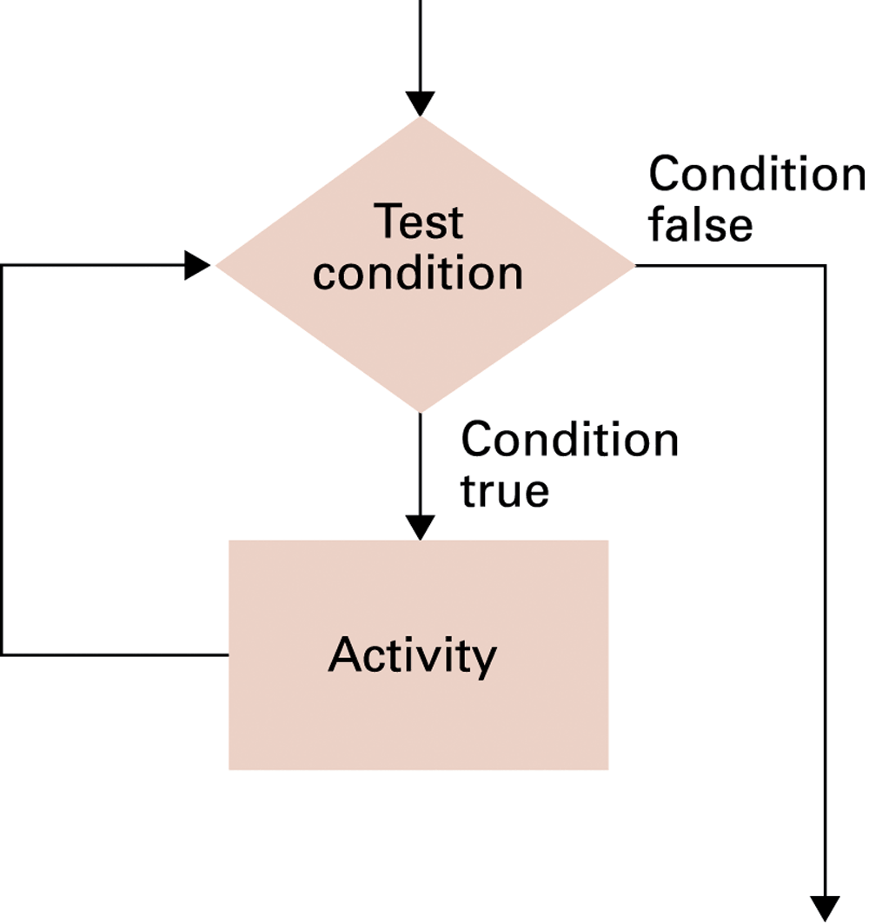
Iteration Structures: repeat as long as a condition is true
Notes:
Arrow shows that loop body (which is indented) is repeated until condition becomes false

Slide 15
Subprogram structures: call a new module
Call Print_header
Call Calculate wages(hours, rate, wages)

